Slide 1

User Interface Design contd.. (Chapter 11- by Roger S. Pressman)

Slide 2
Interface Design Steps
UI Design models state that:
Using information developed during interface analysis, define interface objects (buttons, text fields, video etc.) and operations (tasks)
Define events (user actions) that will change the state of the UI.
Depict each interface state as it will actually look to the end-user. (accomplish using sketches).
Show how the user infer the System state from information provided through the interface.

Slide 3
Interface Design Steps
Apply interface design steps
Define the use-case:
Create the list of objects and actions
These objects & actions are categorized into different type.
Identify which are source (e.g., printer icon), target (e.g., paper) and application objects(e.g., screen, entity/db table).
Use UI design patterns
As specific deign pattern is formulated for a well bounded solution.
E.g., for a calendar UI, a Calendar Strip is created that allows to traverse in future dates, marking the current one.

Slide 4
Interface Design Steps
Design Issues
Some of the issues are:
System Response time
Help facilities
Error handling
Menu & command labelling

Slide 5
Interface Design Steps
Design Issue 1: System Response time
Primary complaint for almost every interactive system
Two characteristics:
Length: longer response times are not appreciated, led to user frustration
Variability: varying response time led to user confusion, like whether something went wrong at backend which is leading to a different response time than average response time.

Slide 6
Interface Design Steps
Design Issue 2: Help Facilitates
Online helpdesk
Detailed user manuals
Design issues while providing Help facilities
Help availability for all functionalities?
How will user demand help? (give menu for that or a function key mapped to that)
How help is presented? (via another window or a printed manual)
How to return to normal UI after consulting help

Slide 7
Interface Design Steps
Design Issue 3: Error Handling
Error messages & warnings are bad news to users when something went wrong.
Error message must be explanatory and should include some remedies for that (via hyperlinks)
A good error message includes:
Describe problem simply
Provide valuable advice
List the negative consequences of the error
Message must prompt visually using a color scheme that easily categorize it as an error.

Slide 8
Interface Design Steps
Design Issue 4: Menu & Command labeling
Different styles like command oriented arch and UI based arch.
Both are used frequently
How commands are assigned to each menu item so that it may run without UI as well.
Design Issue 5: Application Accessibility
UI should cater the needs of the physically challenged persons as well (like some sort of voice inputs could be accepted to facilitate handicapped)
Design Issue 6: internationalization
UI must target the global market
Follow global design standards & facilitate multiple languages.

Slide 9
Revised Interface Design Guidelines for a Web App
Anticipation
Application must depicts the user’s expected move.
E.g., software installation procedures are defined in a way to predict next step for users. They don’t need to search for the next work.
Communication
Application must show the status of an activity initiated by user.
E.g., file copying shown via progress bar
Consistency
The navigation controls, menu, icons, aesthetics should be consistent throughout the application
E.g., like yellow triangle shows warning signs use them for warning messages only.
Controlled autonomy
Revising the golden rule that says place user in control but restrict the controls as per the user’s role.
Enforce id and password for no go options.
Efficiency
Design of the application must work on user’s efficiency.
e.g., input the CNIC or hone no without space or hyphen will lead to less processing time at user end.

Slide 10
Revised Interface Design Guidelines for a Web App
Focus
The interface should help user stay focused and give the relevant options and data first
Fitts's law
Law—“The time to acquire a target is a function of the distance to the target and the size of the target.”
In interactive systems its important to complete tasks quickly so relevant options should be easily accessible and in larger size.
The important buttons should be made bigger to reduce accessibility time
And inter-related targets should be placed together to reduce time.
E.g., in Youtube, sound controls at bottom and near to video and subscribe button bigger
Latency reduction
Interface must do multitasking rather than kept user waiting for an operation to complete
e.g., display a progress bar to show the progress of the task like downloading
Show and animated visuals to keep user focused.

Slide 11
Revised Interface Design Guidelines for a Web App
Learnability
Minimize learning time by creating simple & intuitive designs
Maintain work product integrity
An interface should autosaved the user data
e.g., filling out long forms and loosing data in case of an error in an input field. This leas to frustration. So the data should be saved for all the correct fields.
Readability
All information presented should be readable by all age group users
Track state
Cookies can be used to track user activities so user may logout any time & can continue from the same state after logging in again
Visible navigation
Obvious navigation bars mentioned on every interface of the application.

Slide 12
Interface Design Workflow:
Derive and refine information from requirements
Develop rough layout sketch
Map user objective to actions (like Home, Contact, booking, facililities, etc….)
Create storyboard screen images for every interface
Refine layouts by improving aesthetics
Develop an activity diagram to show the design flow
Develop state diagrams to show changes in state after transitions
Describe interface layout for every state
Refine & review the model.

Slide 13
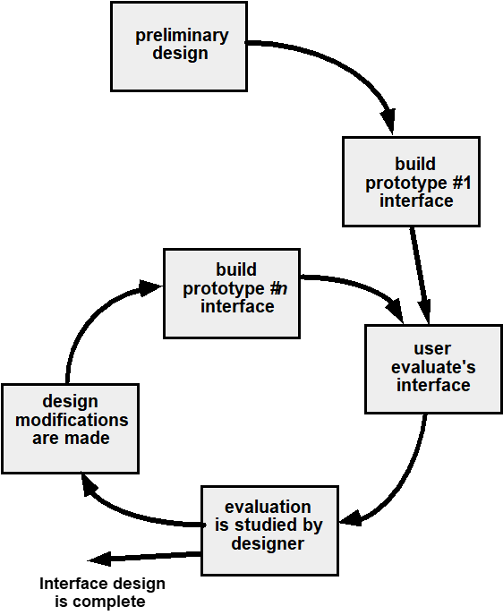
Interface Design Evolution:

